Slide 1



Data for Seagrass Restoration Storymap
This file created Feb 2026 as part of data update and app migration (WAB->EB)
Discussion points:
BESE (understand Jeff’s email) – including both BESE sets for now
Grid plantings - somehow classify or code as grid; treating separately but as points for now
GPS records with planting_geometry=polygon only have two GPS points, treating spatially as lines.
Line plantings “DEL” extends onto land.
Make donor site and donor-assoc tables
Refer to Sankey outline

Slide 2


























Slide 3
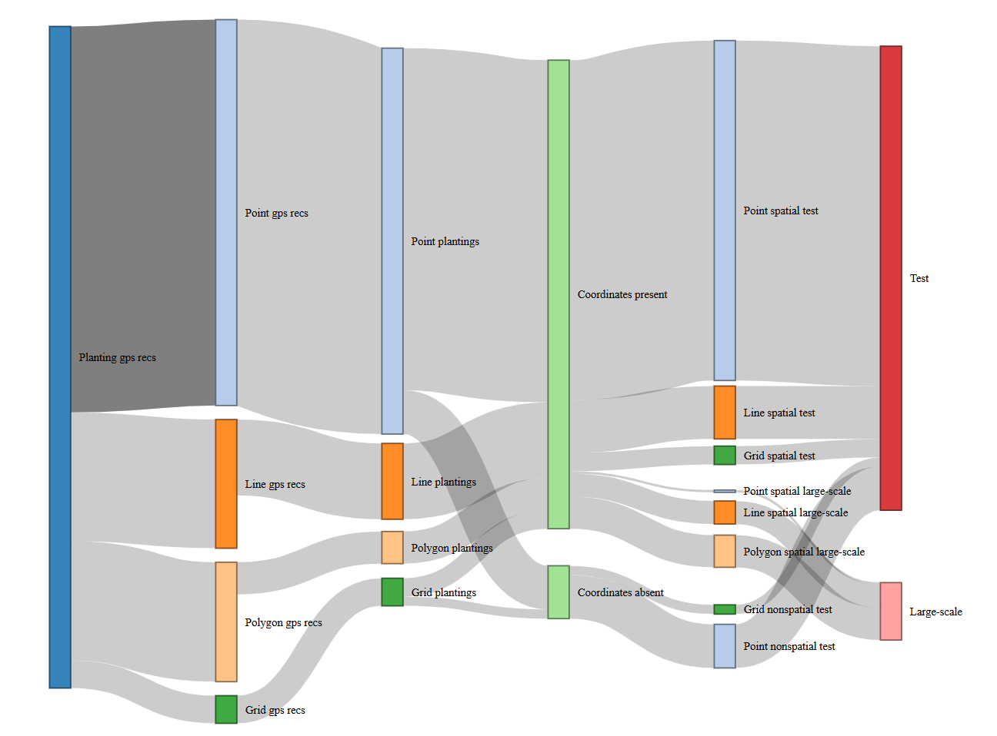

Slide 4
168
Planting location codes
With known coordinates
149
Planting gps recs
288
19
Planting location codes
unknown coordinates
60
35
12
60
60
60
48
12

Slide 5
First need to re-evalutate approach to spatial entities (plantings, planting_location_code, restoration area)
Is there any value to have spatial coords at the planting_location level?
Alternatively, coords could be attributes of each planting; or both planting_location and planting.
Base on code-assisted accounting:
Summary of p_gps_pts, grouped by plantingID in create_lyrs.r, gave
204 plantings with coords present
23 plantings with coords absent
Summary of p_gps_pts, grouped by planting_location_code in create_locations.r, gave
118 good planting locations (with coords)
12 planting locations missing coords
42 planting locations with multiple sets of coords
Need an approach to locations
and an approach to minimize plantings without coords.
Extract planting_locations
from gps points table…
group_by planting_location_code
summarize
reduce site_location (to be restoration area)
historical_presence_source
water_body
svmp_region
latitude
longitude
datum
elevation_m_MLLW
d
Before summarizing by plc, assess the total set of coords associated with each plc

Slide 6
5
1
2
3
4
6
7
8
pt_plantings_cln
149
planting_pt
159
pt_recs
168
pt_plantings
168
gps_recs
288
pt_plantings_no coords
19
Plantings with
coordinates
204
Planting_location_codes
known coordinates
160
Planting_location_codes
known coordinates
165
ln_plantings
35
ln_plantings_1pt
10
Planting_location_codes
known coordinates
5
ln_recs
60
ln_cln_plantings_2pt
25
Plantings with
unknown coords
23
Planting_location_codes
unknown coordinates
18
planting_ln
27
Planting_location_codes
unknown coordinates
18
py_plantings_cln_4pt
9
planting_py
10
py_recs
48
py_plantings
12
py_plantings_cln_3pt
1
py_plantings_cln_2pt
2
grid_plantings_cln
8
planting_gr
8
grid_recs
12
grid_plantings
12
planting relationships within a planting occasion
planting relationships across planting locations
Test / Large-scale
Planting_method
grid_plantings_no coords
4

Slide 7
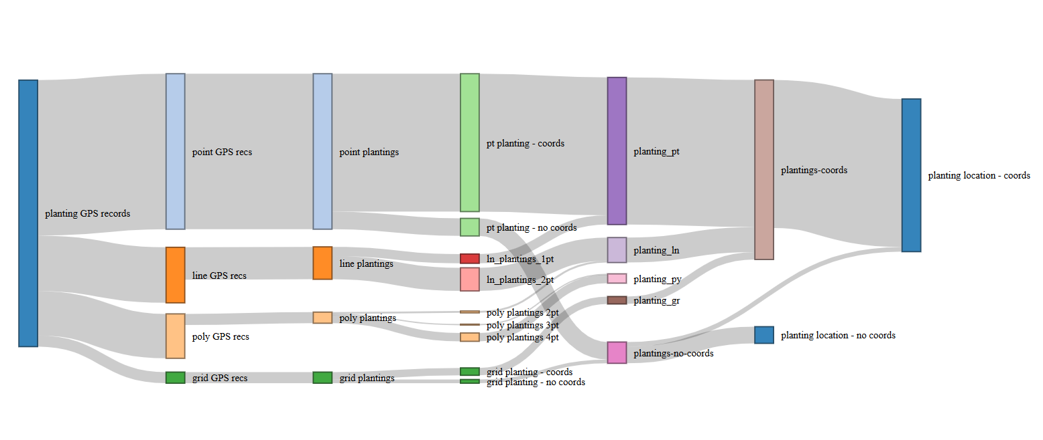
7
2
8
1
3
4
5
6

Slide 9
Working toward list of unique planting_location_codes with spatial/nonspatial breakdown.
With sf, create line and polygon plantings, with the planting_location_code attribute.
Are there multiple line or polygon plantings at same planting_location_code? (if so work out method to assign point coordinates to the planting_location_code, perhaps a centroid across all plantings at that planting_location_code
To create line & polygon planting features:
Summarize by plantingID to get attribute ‘coords_present’
Join back onto gps_points – remove records associated with plantingIDs with coords_present=FALSE
Make sf object. Project.
Group and make lines and polygons
d
Goal is to work around planting_location_codes with multiple sets of coords from different plantings

Slide 10
ok, so sequence is
populate new donor_site field that applies ‘mix’ to all mixes - done
make plantingID that catches the MRE replicate cases - done
make donor_site_association table (that parses all mixes)
make donor_site table
make donor_site_extraction_pt
Then continue with building out tables and compile Sankey data

Slide 11
Logic to construct plantingID
Planting GPS points
Add group number
(activity_filter)
plantings
Add donor_site_code
(from file; clean up Mixed)
Summarize
on group_no
Basic plantings table
Add initial plantingID
Add plantingID_init counts
P_gps_pts
(w/donor_site_code & plantingID)
Left-join
on group_no
Add plantingID
(add replicate suffixes)

Slide 12


matrix
subprojects
p_gps_pts
p_gps_pts
clean
extract
projects
p_gps_pts
extract
plantings
plantings
snapshot
import
donor_sites
Planting_locations
Initial spatial layers
subprojects
Get list of PLC with multiple locations
Get centroids
Plantings_pt
Plantings_ln
Plantings_py
Planting_centroids
(prior to no-coord recovery)
p_gps_pts
plantings
import
import
import
p_gps_pts
p_gps_pts
p_gps_pts

Slide 13
Questions
Two “Mixed” donor site cases. Is the mix of donor plants from the other collocated plantings? YES
3 cases of single polygon planting with different methods at corners. Grid planting. Treat as separate plantings – just the corners as points but with planting_geometry=“grid” (edited in snapshot). This treatment should be subject to revision based on monitoring data granularity.
How to handle MRE replicates. Yes treat as replicates – add to key. Done, and discovered total three sets of replicates.
Use of ‘collocated’ and retain/drop. Collocated confirmed. Ignore retain/drop
Treating BESE as a single planting – or 3 AG BG C; Dumas donor source successful. Dupont Wharf failed.
Plantings at same GPS coords but different dates:
Spread through season: ‘repeat’ plantings
Consecutive days: ‘collocated’ plantings
d
JG email:
sum the number of large scale and test transplant activity types
So, the simpler version of calling BESE a single test transplant effort works here.

Slide 14
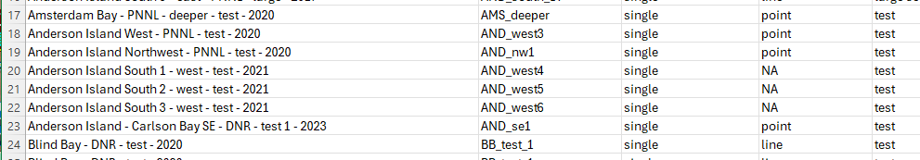
Edits to matrix spreadsheet
Aston citation in two different forms (edit made to snapshot)
Aston, L.A., A.B. Borde and J. Vavrinec. 2015. Final Summary Report - Eelgrass Restoration in Puget Sound Project Summary. Pacific Northwest National Laboratory, Richland, WA. PNNL-24445.
Aston, L.A., A.B. Borde and J. Vavrinec. 2015. Final Summary Report - Eelgrass Restoration in Puget Sound Project Summary. Pacific Northwest National Laboratory, Sequim, WA. PNNL-24445
Manually changed all in snapshot to be Sequim version
Modified headers rows so that a clean set of column titles (no spaces, symbols) is immediately adjacent to the table (edit made to “_pd” version that propagated to snapshot). The number of rows at the top to ignore is stored in a config file.
3 Anderson island plantings: NA changed to “point”
added planting location codes to the one BESE group that had NA
changed activity_filter values for each of the two BESE groups so that each row of p_gps_pts is a distinct planting (no instances of “--”)
added planting geometry (col G) as ‘point’ for two planting_gps_pt records:
Delano Beach West - DNR - shallow - test – 2021
Delano Beach West - DNR - deep - test - 2021

Slide 15
Edits to matrix spreadsheet
Joemma Beach State Park North - SE - DNR - methods - 2017
Joemma Beach State Park North - SW - DNR - methods - 2017
Joemma Beach State Park North - NE - DNR - methods - 2017
Joemma Beach State Park North - NW - DNR - methods - 2017
Joemma Beach State Park Mid - SE - DNR - methods - 2017
Joemma Beach State Park Mid - SW - DNR - methods - 2017
Joemma Beach State Park Mid - NE - DNR - methods - 2017
Joemma Beach State Park Mid - NW - DNR - methods - 2017
Joemma Beach State Park South - SE - DNR - methods - 2017
Joemma Beach State Park South - SW - DNR - methods - 2017
Joemma Beach State Park South - NE - DNR - methods - 2017
Joemma Beach State Park South - NW - DNR - methods - 2017
Planting_geometry in snapshot changed from ‘polygon’ to ‘grid’
Changed 3 sets of polygon GPS points to ‘grid’
Changed activity filter so separate plantings
JSP_north_P1__2017-05-26__multiple__DPW
Changed column name of second planting_geometry
Change planting_geometry from polygon to line for the 2 AND_South_L2 records and the 2 AND_South_L3 records

Slide 16
using activity_filter for grouping points associated with the same planting.
Activity_type field seems robust for grouping points by planting – with BESE and MRE exceptions and grid
The rep cases remain; i.e., groups from activity_filter correctly identifies certain sets of records as discrete plantings, but the planting key does not distinguish them (multiple records associated with same planting key).
what is frequency of multi-record groups - how many reflect geometry and how many represent reps, or other cases?
How relates to earlier frequency summary, by planting key?
planting key: planting_location_code + planting_date + method + donor_site_code
identify all reps and number “_r1”, “_r2”, “r3”, …
Breakdown collocated field. Identify cases of plantings at same location, different dates.
Need to identify fields across all tables that are required for data entry
Workflow for integrating new data from Survey 123. Append or overwrite?

Slide 17

















Point
records
single
point planting
Solo
line endpoint
records
test
all plantings
Collocated
initial
line planting
polygon diagonal
records
Replicates
large scale
polygon planting
repeat
polygon 4 corner
records
288
Add project associations
all rows

Slide 18



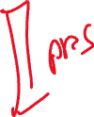












Slide 19
Source | Target | Value
Planting gps recs | Point gps recs | 168
Planting gps recs | Line gps recs | 56
Planting gps recs | Polygon gps recs | 52
Planting gps recs | Grid gps recs | 12
Point_gps_recs | Point plantings | 168
Line gps recs | Line plantings | 33
Polygon gps recs | Polygon plantings | 14
Grid gps recs | Grid plantings | 12
Point plantings | Coordinates present | 149
Point plantings | Coordinates absent | 19
Line plantings | Coordinates present | 33
Polygon plantings | Coordinates present | 14
Grid plantings | Coordinates present | 8
Grid plantings | Coordinates absent | 4
Coordinates present | Point spatial test | 148
Coordinates present | Point spatial large-scale | 1
Coordinates present | Line spatial test | 23
Coordinates present | Line spatial large-scale | 10
Coordinates present | Polygon spatial large-scale | 14
Coordinates present | Grid spatial test | 8
Coordinates absent | Point nonspatial test | 19
Coordinates absent | Grid nonspatial test | 4
Point spatial test | Test | 148
Line spatial test | Test | 23
Grid spatial test | Test | 8
Point spatial large-scale | Large-scale | 1
Line spatial large-scale | Large-scale | 10
Polygon spatial large-scale | Large-scale | 14
Point nonspatial test | Test | 19
Grid nonspatial test | Test | 4
Sankey data
geometry | Spatial / non-spatial | Test count | Large count
point | spatial | 148 | 1
line | spatial | 23 | 10
poly | spatial | 0 | 14
grid | spatial | 8 | 0
point | nonspatial | 19 | 0
grid | nonspatial | 4 | 0

Slide 20
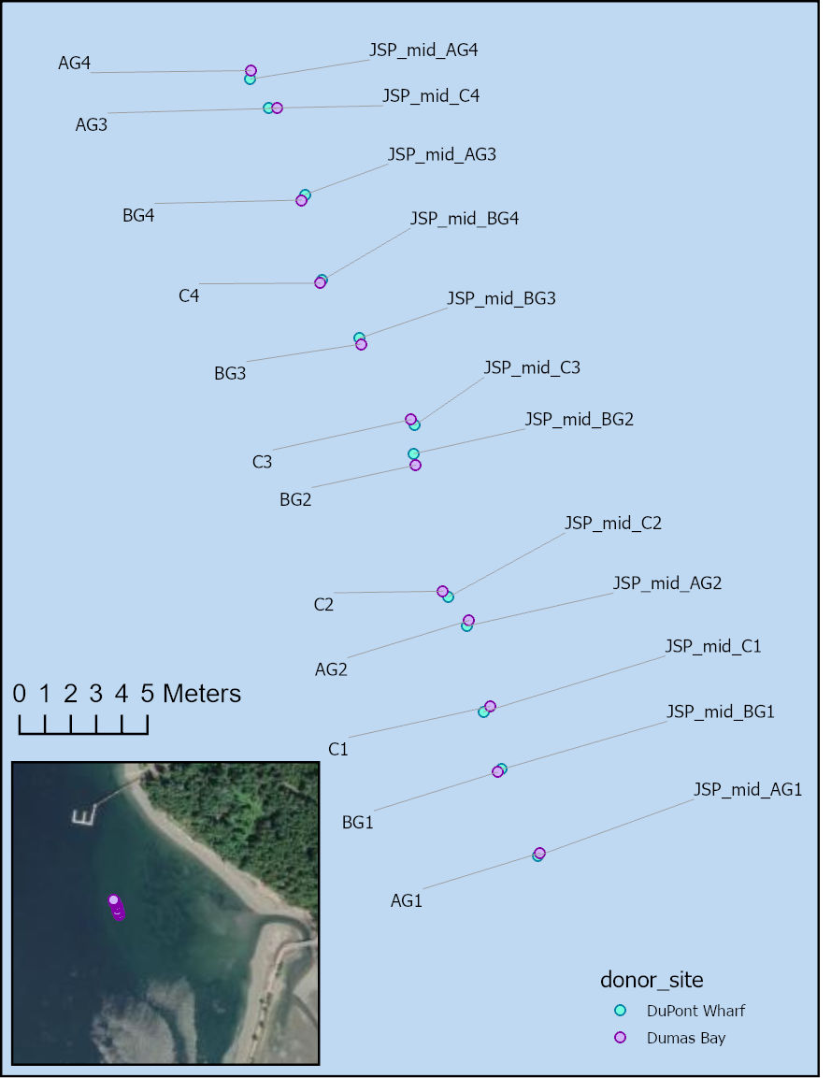
Clarifying BESE plantings
Donor site | Planting_date | Notes
Dupont Wharf | 5/25/2017 | Biodegradable ecosystem engineering elements (BESE) for Marjolijn Christianen, Wageningen University & Research, Netherlands. Overall area was 1 m2. Actual was 0.1 m2 (10 x 10 cm area in center of BESE. 3 planting units with 4 shoots each. DuPont Wharf shoots.
Dumas Bay | 4/29/2017 | BESE setup version 1 - setup was incorrect. Rather than removing all the eelgrass, it was left in place and new BESEs set just westward. 3 planting units with 4 shoots each. Dumas Bay shoots.
Monitoring data in Matrix spreadsheet only for plantings on 5/25/2017
Notes from last meeting:
Dumas Bay successful
Dupont Wharf failed
Q1: If Dumas Bay plantings successful, the monitoring data should presumably track the 4/29 plantings, not 5/25. Is that right?
Q2: The 4/29 “setup was incorrect” plantings were superceded by “just westward” plantings. Can we associate same GPS coords with the westward plantings? If Dumas plantings were successful, this refers to the westward plantings – is that right?

Slide 21
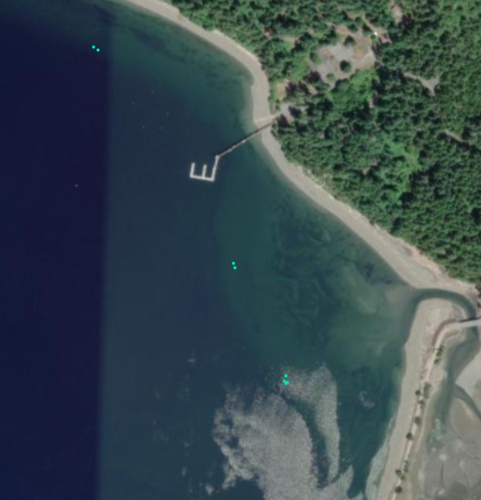
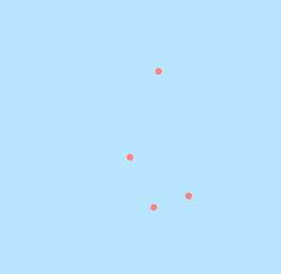
JSP_north_P1
JSP_mid_P1
JSP_south_P1

Slide 22

























Slide 23









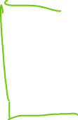






planting_GPS_pts
plantings
monitoring_events
assessments
donor_sites

Slide 24
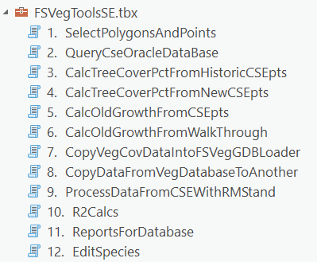


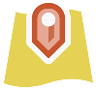

Seagrass Restoration web service
A tool to update ArcGIS Online feature layer from Excel source data
Data flow & components
>_
SeagrassRestorationTools
Spreadsheet tables (sheets)
Construct geometry tables
Update Planting Web Layers
QA &
clean
Validate Planting Tables
planting_GPS_pts
plantings
Construct spatial layers
Data summary
monitoring_events
Read from Excel
assessments
Write to fgdb
memory
cloud
donor_sites
disk
Update AGOL feature layer
Matrix
Version management?
Is writing to fgdb on disk necessary? (network GIS restoration dataset; where?)
Can the API for Python update an AGOL feature layer from data in memory?

Slide 25
Matrix Workflow -- Versioning / Archiving
SeagrassRestorationTools
Update Planting Web Layers
working
Validate Planting Tables
SeagrassRestorationTools
Update Planting Web Layers
archive2024
Validate Planting Tables
archive2025
archive2026
snapshot_20240101
SeagrassRestorationTools
Update Planting Web Layers
snapshot_20250301
Validate Planting Tables
working
snapshot_20260501

Slide 26
planting_GPS_points
Original | Revised
SITE LOCATION | site_location
SITE NAME | site_name
planting_location_code | planting_location_code
planting_relationships | planting_relationships
YEAR | year
HISTORICAL PRESENCE | historical_presence_source
DATA TYPE | planting_geometry
WATER BODY | water_body
SVMP REGION | svmp_region
PROJECT NAME | project_name
FUNDING SOURCE | funding_source
FUNDING SOURCE PROGRAM | funding_source_program
CONTRACT 1 | sponsor_contract_number
CONTRACT 1 | sponsor_contract_dnr_number
CONTRACT 2 | contractor
CONTRACT 2 | contract_dnr_number
CITATION | citation
ACTIVITY TYPE | activity_type
ACTIVITY FILTER | activity_filter
PLANTING DATE | planting_date
LATITUDE | latitude
LONGITUDE | longitude
data_type | planting_geometry
retain_drop | retain_drop
DATUM | datum
ELEVATION | elevation_m_mllw
PLANTING METHOD | planting_method
PARALLEL SIDE | parallel_length_m
PERPENDICULAR SIDE | perpendicular_length_m
PLOT AREA | plot_area_m2
PLANTED AREA | planted_area_m2
EFFECTIVE AREA PLANTED | effective_area_planted_m2
# OF PLANTING UNITS | number_planting_units
# OF SHOOTS | number_shoots
PLOT SHOOT DENSITY | plot_shoot_density_m2
PLANTED SHOOT DENSITY | planted_area_shoot_density_m2
DONOR SITE NAME | donor_site_name
NOTES | notes
Changes to Matrix Column Names
Attributes of plantings
plantings
Original | Revised
SITE NAME | site_name
planting_location_code | planting_location_code
planting_relationships | planting_relationships
data_type | planting_geometry
retain_drop | retain_drop
Are there ever cases of multiple donor sites utilized for a single planting?
Attributes of plantings

Slide 27
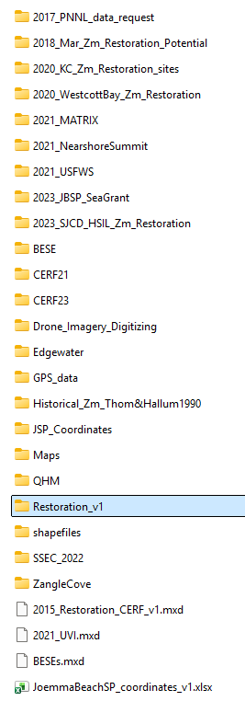
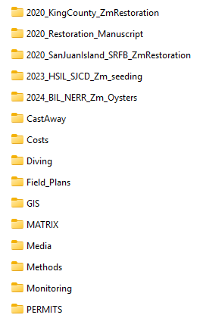
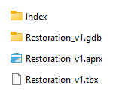

Two roles for restoration GIS dataset:
Authoritative GIS data in central location for internal users (“production”)
Location for ArcGIS tool to write GIS data updates. Ideal workflow would write to non-production dataset to allow for review before replacing production copy.
K:\projects\Eelgrass_Restoration

Slide 28
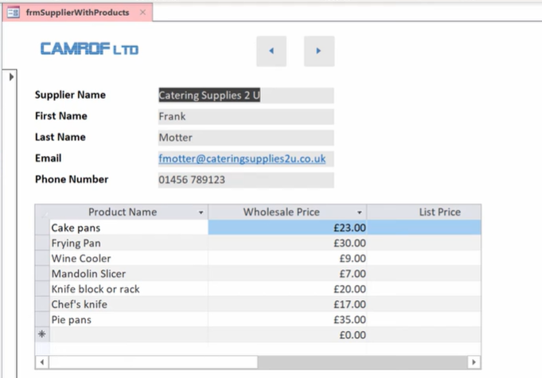
Data entry into multiple related tables
Using Access forms and subforms

Slide 29

planting_locations
planting_event_gps_pts
Matrix
spreadsheet
plantings
donor_sites
feature layers
pt_plantings
ln_plantings
py_plantings
feature layers
planting_regions
planting_all_pts
py_plantings
new
planting
data
Survey 1-2-3
planting_event_gps_pts_newrecs
planting_newrecs

Slide 30
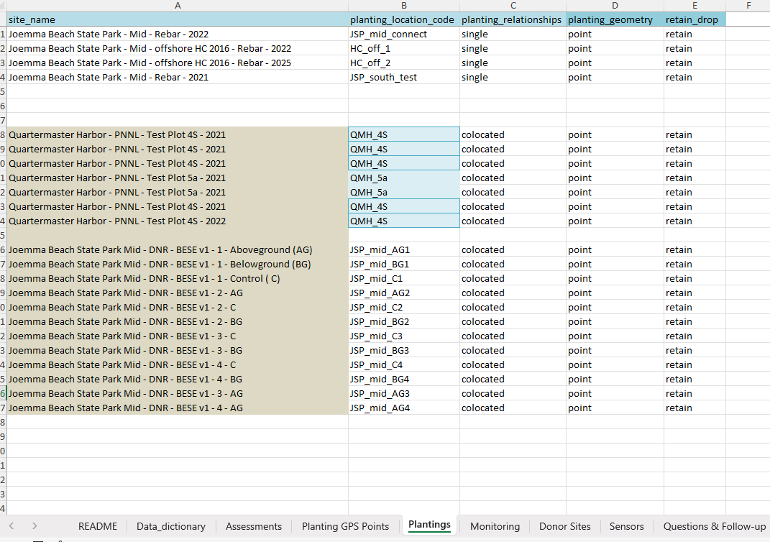
“point” and “retain” added for these records in the snapshot “Plantings” sheet.

Slide 31
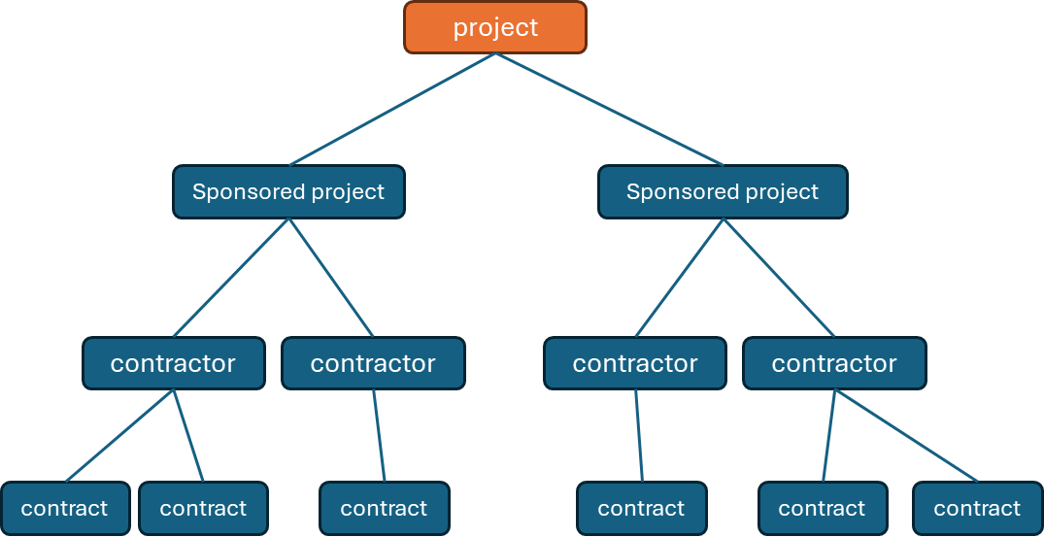
project
Sponsored project
Sponsored project
contractor
contractor
contractor
contractor
contract
contract
contract
contract
contract
contract
sub-project code = project_code + funding source + contractor

Slide 32
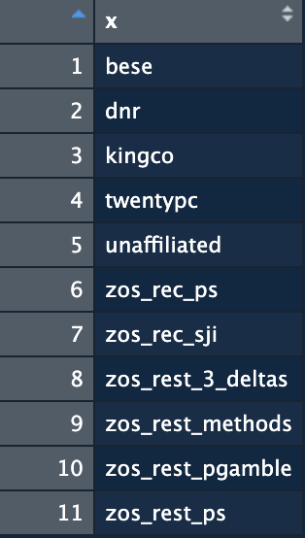
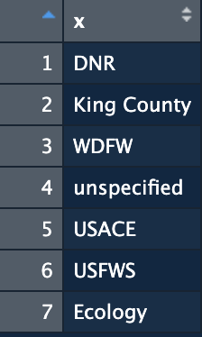
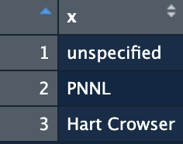
sub-project code
funding source
=
project code
+
+
contractor

Slide 33






Eelgrass Restoration Matrix_2021_0113abb_jg_pd_v1_pd.xlsx
Fixed funding source & activity-type equations (Monitoring sheet)
Renamed tabs:
Plantings → Planting_GPS_Points
lookup_table → Plantings
Modified header column names
Lower case, no spaces
Some new names
Eelgrass Restoration Matrix_2021_0113abb_jg_pd_v1.xlsx
README
Data_dictionary
Assessments
Planting GPS Points
Plantings
Monitoring
Donor Sites
Sensors
Questions & Follow-up
Missing Data
Success Rates

Slide 34
Need automated processing and publishing (will require development time)
Balancing expedient update with movement toward automation
Online feature layer – made ER diagram
Made ER diagram (table relationships)
Update graphs?
Keep donor-planting links (line features)?
Any need for line and polygon feature classes for plantings?
Matrix spreadsheet
Suggested sheet name changes for clarity
Greater automation will require a ‘production’ tables (i.e. clean & systematic)
planting_relationship attribute ??
Domain = {single, initial, repeat, collocated}
Retain_drop (shift to automated determination?)

Slide 35
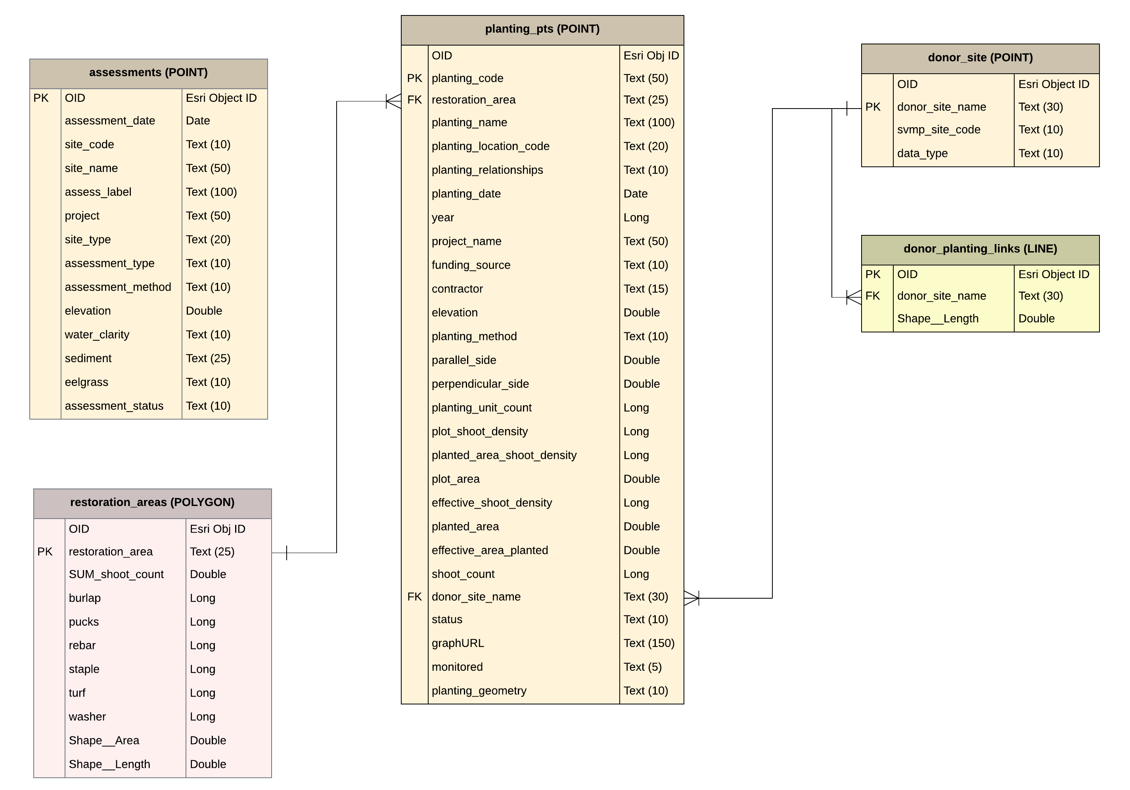
Seagrass Restoration
ArcGIS Online feature layer
Feb. 20, 2026 (prior to update)
Contains five spatial sublayers – point (3), line (1) and polygon (1).
Associated attribute tables shown here in an ER diagram (Entity-Relationship).

Slide 36
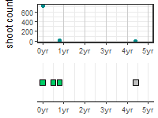
? “point”
planting_code
QMH_3D_20180601_rebar
JSP_mid_1_20180714_rebar
JSP_mid_1_20180714_pucks
Text (8000)
planting_location_code
planting_method
“Planted Shoots”
planting_date

Slide 37
planting_centroids.csv
Planting
entity: planting GPS points
unique
planting ID & edits
Planting_edit
planting_v0.csv
import, project & make lines/polys
planting_pt.csv
planting_pt
planting_pt_all
edits & split data,
create
”plantings” table
planting_ln.csv
planting_ln
planting_poly.csv
planting polygons
plantings_table.csv
planting_pts_all.csv
area_method_join_table.csv
filter out second header row
filter out rows missing lat/lon & related rows (same planting)
rename all columns
summarize methods by location
restoration area polygons

Slide 40
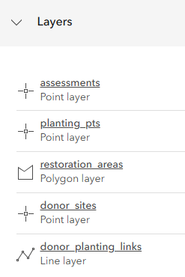

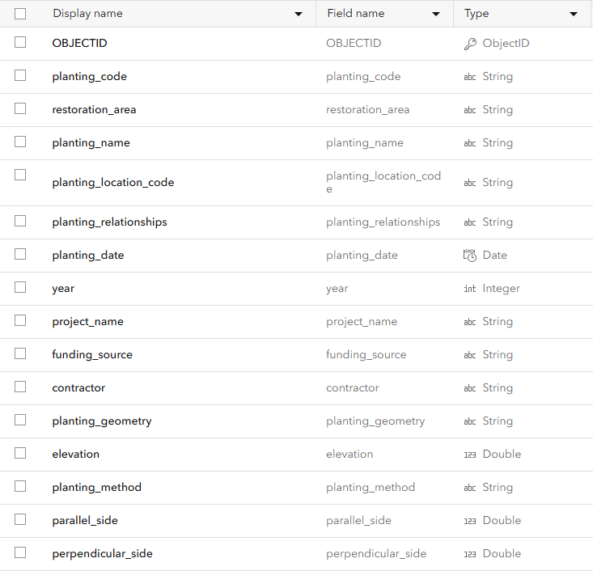
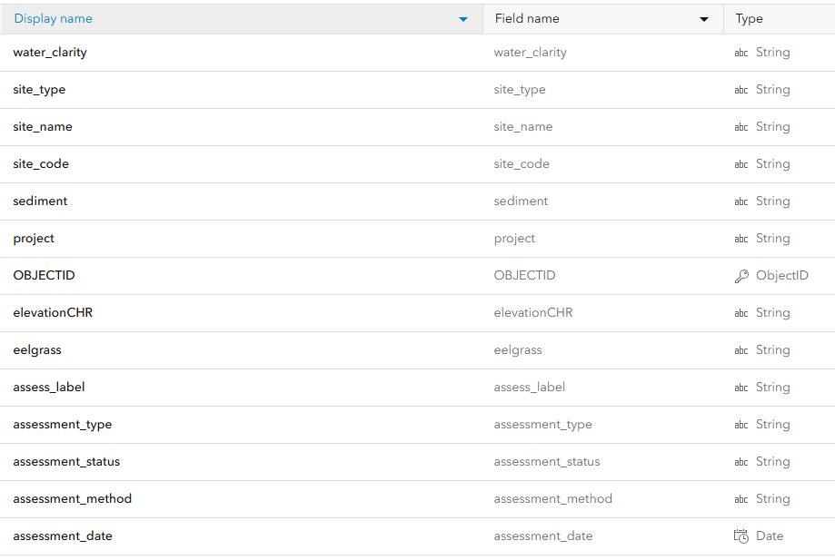
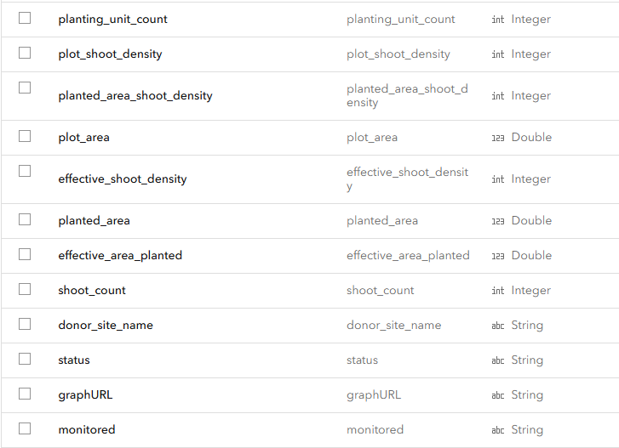
Seagrass restoration storymap supported by 1 feature layer with 5 sub-layers
assessments
Planting_pts

Slide 41
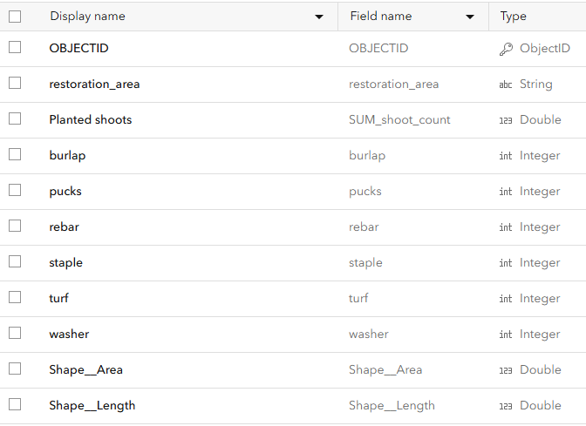
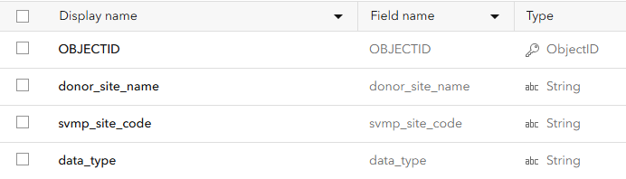
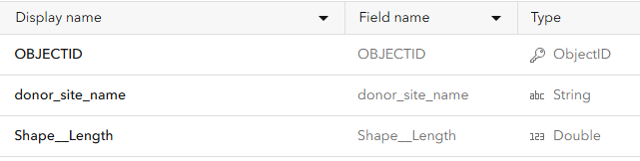
Restoration_areas
Donor_sites
Donor_planting_links

Slide 42

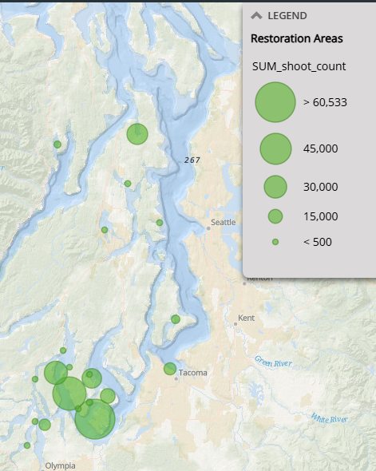
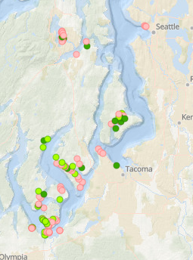
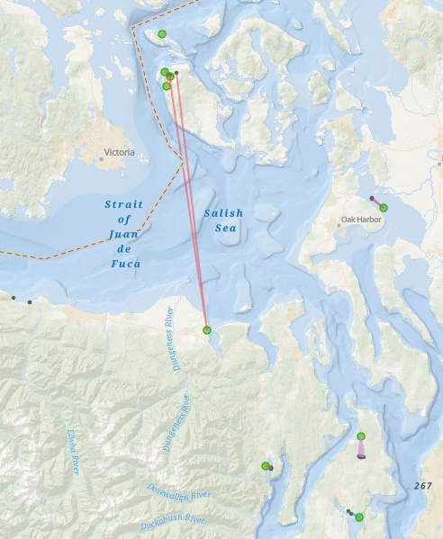
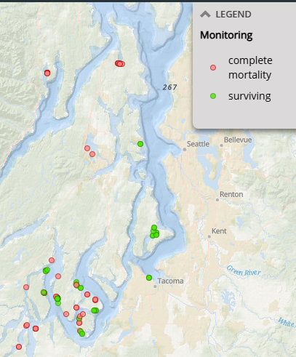
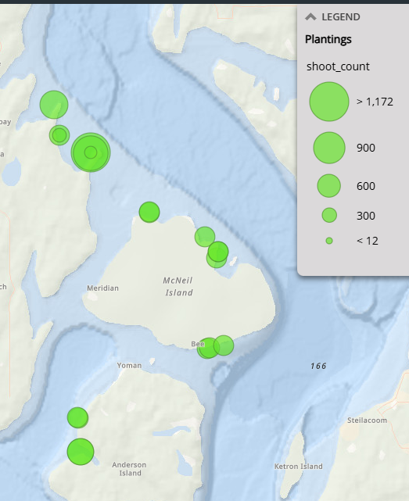
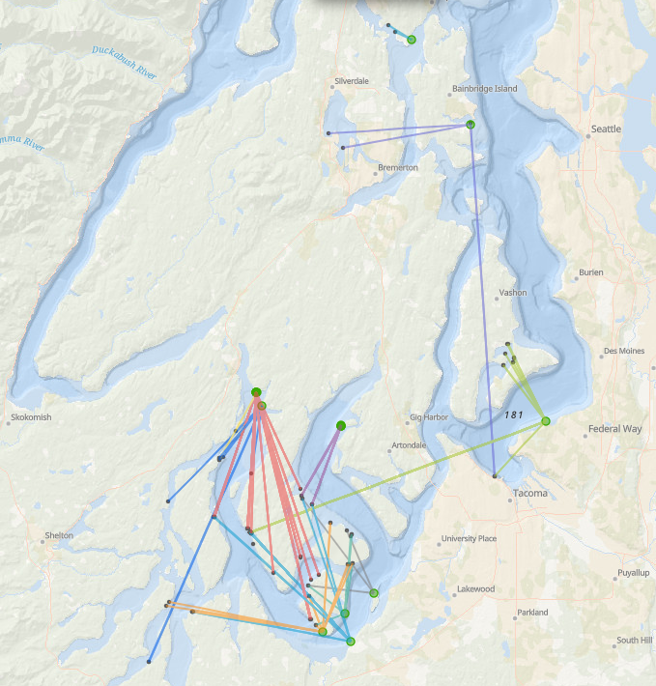

Slide 44
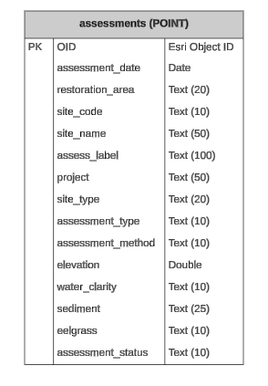
Reconciling existing feature layer attribute tables with Lucidchart ER diagram
assessments
N=15
N=14

Slide 45
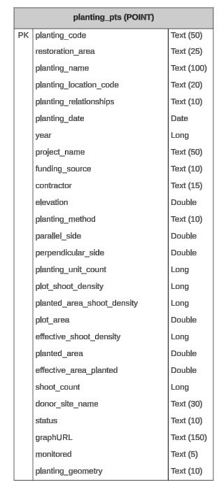
Planting_pts
N=23
N=22

Slide 46
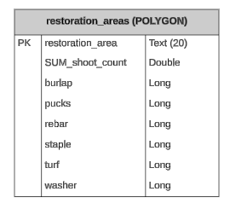
Restoration_areas

Slide 47
